Slide 1
project on business setup for an indian restaurant in dubai
by, Annette Nayana Palanna

Slide 2
introduction
Business Problem
Study is focused to detect a prime location in Dubai which aids stakeholders to set up an Indian cuisine restaurant located in Metro vicinity.
The attributes taken into consideration are:
Number of Indian restaurants, other restaurants and Hotels
Population density
House price index
Tourist attractions

Slide 3
data acquisition and cleaning
Data for the analysis is extracted from Bayanat UAE website: http://data.bayanat.ae/en_GB/dataset/metro-stations/resource/666412a8-3383-47df-b521-c70150698e6a
Dataset has 50 Metro stations in total that fall under 2 lines – Red line and Green line.
Red line has 29 stations and 19 stations on green line having two intersections on Burjuman Metro station and Union Metro station.
The cleaned contains 48 Metro stations.

Slide 4
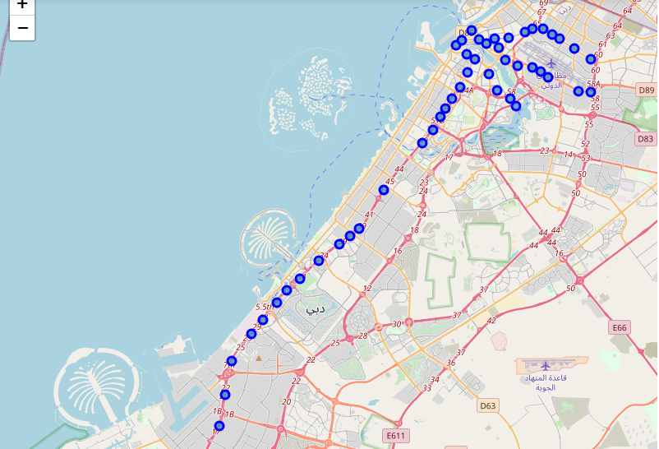
display of metro stations on a folium map

Slide 5
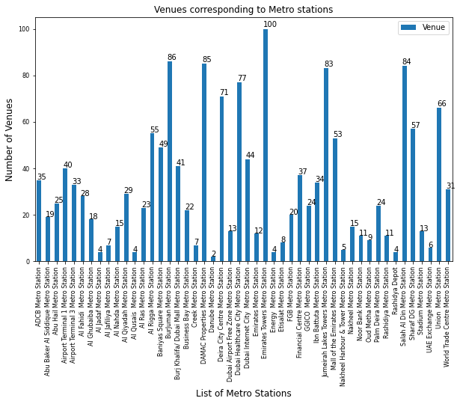
the total number of venues corresponding to each metro station.

Slide 6
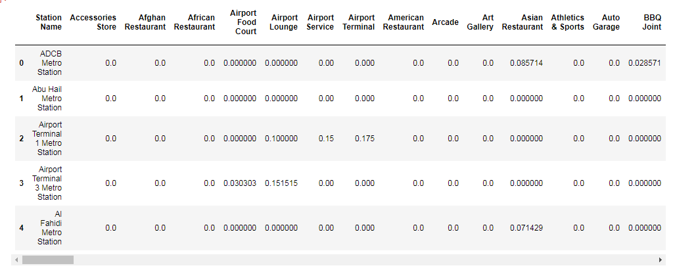
one-hot encoding
For analysis categorical variables of the dataframe are converted to numerical data.
Mean value is calculated on data and grouped based on station name.

Slide 7
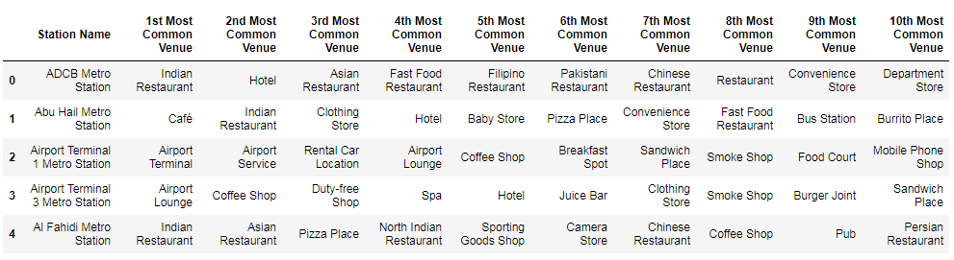
top 10 venues corresponding to each station
The resulting dataframe consist of 196 venues.

Slide 8
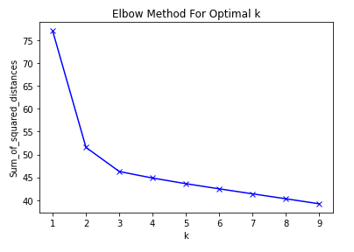
k-means clustering
Clustering algorithm employed in this project is iterative and uses Euclidean-based similarity measures.
Optimal value of K is obtained from the Elbow method.

Slide 9
folium map representation of clusters
Cluster 0 in red - 5 stations.
Cluster 1 in purple - 18 stations.

Slide 10
cluster visualization using catplot
Cluster 0 comprises of arbitrary venues which is out of scope. It is observed that hotel, restaurants, coffee shop and café categories fall under Cluster 1 which is the prominent feature in this study.

Slide 11
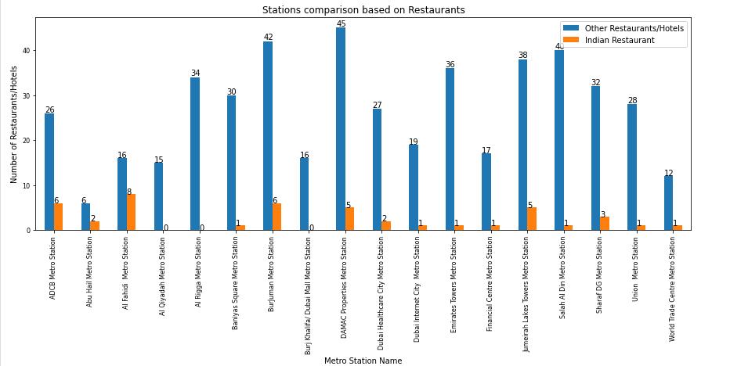
comparison on indian restaurant vs other restaurants

Slide 12
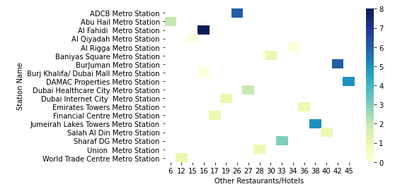
heatmap visualization
Each square of the heatmap represents a cell which displays density of Indian restaurants ranging from low to high density value.

Slide 13
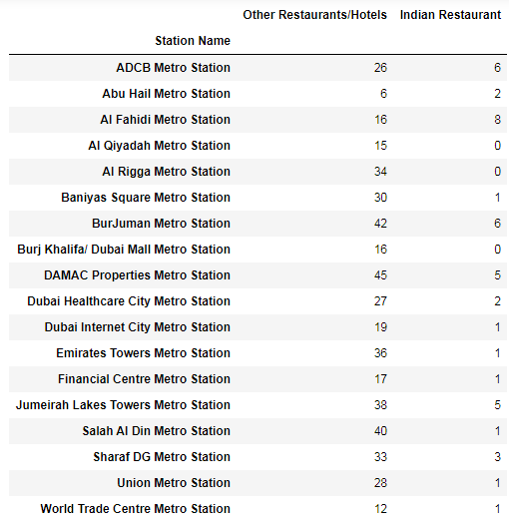
results and discussions

Slide 14
results and discussions
The following results are compared with House price index, Population density, Tourist attractions for 18 Metro stations.
Low-density of Indian restaurants
Burj Khalifa Metro - Premium cost for business setup.
Al Rigga Metro - Most suitable for the business.
Al Qiyadah Metro - Away from city, not a great location for the business.
Mid-density of Indian restaurants
Baniyas Square Metro - Most suitable for the business.
Emirates Tower Metro, Financial Centre Metro, World Trade Centre Metro - Premium cost for business setup.
Dubai Internet City Metro - Premium cost for business setup.

Slide 15
results and discussions
Salah Al Din Metro station and Union Metro – Most suitable for the business.
High-density of Indian restaurants
Abu Hail Metro - Most suitable for low-budget business.
Dubai Healthcare city Metro - Away from city, not a great location for the business.
Sharaf DG Metro - Most suitable for the business.
All other 5 Metro stations fall under hottest region on heatmap with highest density of Indian restaurants will not be the best suit for the business.

Slide 16
Conclusion
The objective of this project was to detect the optimal location for Indian cuisine restaurants within 500 meter radius with less or no competition.
By considering restaurant density distribution from heatmap, we have identified several potential candidate stations by looking at Population density, popular tourist attractions and House price index with no/less competitions which will aid stakeholders in tapering the search for the most favorable business investment.
The final decision in deriving an optimal location is solely based on preferences of stakeholders.

Slide 17


